Slide 1
Using nanoparticles co-modified with borneol and lactoferrin to treat Parkinson’s disease
Nanoparticles in Brain Therapy
Raegan Nelson
November 22, 2019
This Photo by Unknown Author is licensed under CC BY-SA-NC

Slide 2
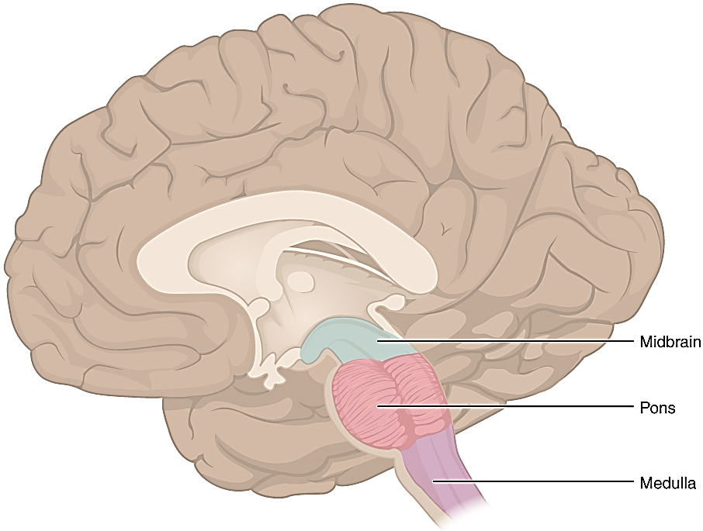
Parkinson’s disease
Midbrain
2nd most common progressive neurodegenerative disorder
Loss of dopaminergic (DA) neurons in substantia nigra of midbrain
Pons
Medulla
Betts, et al. (2013)
Notes:
Betts, J. G., Young, K. A., Wise, J. A., Johnson, E., Poe, B., et al. (2013). Anatomy and physiology: Chapter 13.2 The Central Nervous System. House, TX: OpenStax. Retrieved online from: https://openstax.org/books/anatomy-and-physiology/pages/13-2-the-central-nervous-system

Slide 3
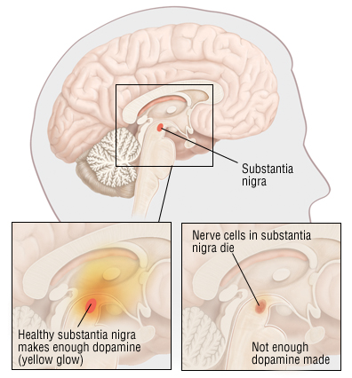
Parkinson’s disease
2nd most common progressive neurodegenerative disorder
Loss of dopaminergic (DA) neurons in substantia nigra of midbrain
Harvard Medical School (2018)
Notes:
Harvard Medical School. (2018). Parkinson’s disease. Retrieved from: https://www.health.harvard.edu/a_to_z/parkinsons-disease-a-to-z

Slide 4
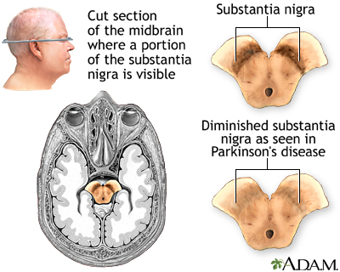
Parkinson’s disease
2nd most common progressive neurodegenerative disorder
Loss of dopaminergic (DA) neurons in substantia nigra of midbrain
Campellone (2018)
Notes:
Campellone, J. (2018). Substantia nigra and Parkinson disease. Retrieved from: https://medlineplus.gov/ency/imagepages/19515.htm

Slide 5
Parkinson’s disease: why do we care to study it?
Loss of DA signaling, as in Parkinson’s disease, leads to symptoms like:
Hypokinesia (decrease in muscle movement)
Bradykinesia (slowing of muscle movement)
Rigidity
Resting tremor
Freezing of gait
Nonnekes, et al. (2015)
Notes:
Nonnekes, J., et al. (2015). Freezing of gait: a practical approach to management. The Lancet, 14(7), 768-778. doi: https://doi.org/10.1016/S1474-4422(15)00041-1

Slide 6
Parkinson’s disease: why do we care to study it?
Signaling through substantia nigra = crucial for proper control of movement and coordination
Simply put, DA neurons in substantia nigra help us:
Promote movements we want
Inhibit movements we do not want
Solar22 (2019)
Notes:
Solar22. (2019). A hand have tremor symptom while reaching for glass of liqueur. Retrieved from: https://fineartamerica.com/featured/a-hand-have-tremor-symptom-while-reaching-for-a-glass-of-liqueur-solar22.html

Slide 7
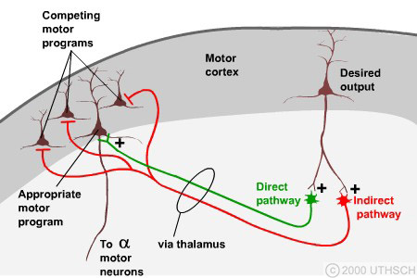
Healthy brain: control of movement
Normally:
direct pathway activates movement we want
indirect pathway inhibits movements we don’t want
Substantia nigra DA neurons help control pathways
Knierim, Chapter 4: Basal ganglia
Notes:
Knierim, J. Chapter 4: Basal ganglia. Retrieved from: https://nba.uth.tmc.edu/neuroscience/m/s3/chapter04.html

Slide 8
Parkinson’s brain: loss of control
Parkinson’s brain:
direct pathway unable to activate movement we want as readily (think freezing of gait symptom)
indirect pathway unable to inhibit movements we don’t want as well (think tremor symptom)
Substantia nigra DA neurons help control pathways
Knierim, Chapter 4: Basal ganglia
Notes:
Knierim, J. Chapter 4: Basal ganglia. Retrieved from: https://nba.uth.tmc.edu/neuroscience/m/s3/chapter04.html
TAKE AWAY: PD can be very debilitating and understanding how to slow its detrimental effects can help significantly improve the quality of life for those suffering form PD

Slide 9
The problem: Drugs do exist to treat Parkinson’s already…
Major goal = increase dopamine signaling in brain
Two major approved drugs are L-DOPA and Neupro
L-DOPA (Levodopa) = DA precursor, oral administration
Neupro (Rotigotine): DA agonist, transdermal patch
Frampton (2019); Gandhi (2019)
Notes:
L-DOPA gets converted to dopamine in CNS and periphery
Frampton, J. E. (2019). Rotigotine transdermal patch: A review in Parkinson’s disease. CNS Drugs, 33(7), 707-718. doi: https://doi.org/10.1007/s40263-019-00646-y
Gandhi, K. R. (2019). Levodopa (L-Dopa). StatPearls Publishing. Retrieved from: https://www.ncbi.nlm.nih.gov/books/NBK482140/

Slide 10
The problem: …but the existing drugs are ineffective over time
Less responsive as disease progresses
Poor BBB permeation
Poor drug-release kinetics (peripheral adverse effects)
New approach:
deliver dopamine to brain using nanoparticles
Tang, et al. (2019); Yan, et al. (2018); Zhang, et al. (2013)
Notes:
Tang, S., Wang, A., Yan, X., Chu, L., Yang, X., et al. (2019). Brain-targeted intranasal delivery of dopamine with borneol and lactoferrin co-modified nanoparticles for treating Parkinson’s disease. Drug Delivery, 26(1), 700-707. doi: https://doi.org/10.1080/10717544.2019.1636420
Yan, X., Xu, L., Bi, C., Duan, D., Chu, L., et al. (2018). Lactoferrin-modified rotigotine nanoparticles for enhanced nose-to-brain delivery: LESA-MS/MS-based drug biodistribution, pharmacodynamics, and neuroprotective effects. International Journal of Nanomedicine, 13, 273-281. doi: http://dx.doi.org/10.2147/IJN.S151475
Zhang, L., Han, L., Qin, J., Lu, W., & Wang, J. (2013). The use of borneol as an enhancer for targeting aprotinin-conjugated PEG-PLGA nanoparticles to the brain. Pharm Res, 30, 2560-2572. doi: 10.1007/s11095-013-1055-y

Slide 11
Using nanoparticles (NPs) for drug delivery to brain
Nasal administration can circumvent BBB
NP can be conjugated with ligands for receptors naturally expressed in nasal neuroepithelium to get to brain
Benefits of NPs for brain drug delivery include:
Reduced off target distribution of drug
Avoidance of first-pass metabolism of drugs in blood
Quicker delivery to brain
Potentially lower drug dose required (and reduce toxicity)
Tang, et al. (2019); Yan, et al. (2018)
Notes:
Noninvasive
Olfactory and trigeminal nerves from nasal olfactory epithelium circumvent BBB
Tang, S., Wang, A., Yan, X., Chu, L., Yang, X., et al. (2019). Brain-targeted intranasal delivery of dopamine with borneol and lactoferrin co-modified nanoparticles for treating Parkinson’s disease. Drug Delivery, 26(1), 700-707. doi: https://doi.org/10.1080/10717544.2019.1636420
Yan, X., Xu, L., Bi, C., Duan, D., Chu, L., et al. (2018). Lactoferrin-modified rotigotine nanoparticles for enhanced nose-to-brain delivery: LESA-MS/MS-based drug biodistribution, pharmacodynamics, and neuroprotective effects. International Journal of Nanomedicine, 13, 273-281. doi: http://dx.doi.org/10.2147/IJN.S151475

Slide 12
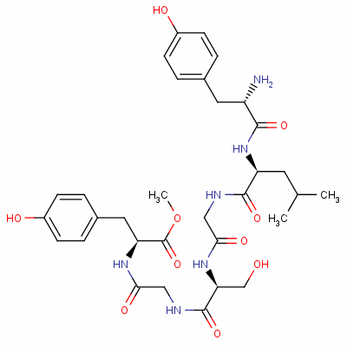
Supporting Paper 1: Lactoferrin-modified nanoparticles
What is lactoferrin?
Iron-binding glycoprotein belonging to transferrin family
Natural ligand for lactoferrin receptors, which are highly expressed on:
Respiratory epithelial cells
Brain endothelial cells
Neurons
Unknown (Hypothesis to test)
Will lactoferrin-conjugated NPs delivered intranasally increase Rotigotine delivery to brain?
Intranasal delivery route!
Lactoferrin
ChemNet, CAS No. 117667-25-1; Yan, et al. (2018)
Notes:
ChemNet. CAS No: 117667-25-1, Chemical name: lactoferrin. Retrieved from: http://www.chemnet.com/cas/en/117667-25-1/lactoferrin-(318-323).html
Yan, X., Xu, L., Bi, C., Duan, D., Chu, L., et al. (2018). Lactoferrin-modified rotigotine nanoparticles for enhanced nose-to-brain delivery: LESA-MS/MS-based drug biodistribution, pharmacodynamics, and neuroprotective effects. International Journal of Nanomedicine, 13, 273-281. doi: http://dx.doi.org/10.2147/IJN.S151475

Slide 13
Supporting Paper 1 Major Results
Lactoferrin modified NPs showed sustained DA release compared to naked NPs
Yan, et al. (2018)
Notes:
Yan, X., Xu, L., Bi, C., Duan, D., Chu, L., et al. (2018). Lactoferrin-modified rotigotine nanoparticles for enhanced nose-to-brain delivery: LESA-MS/MS-based drug biodistribution, pharmacodynamics, and neuroprotective effects. International Journal of Nanomedicine, 13, 273-281. doi: http://dx.doi.org/10.2147/IJN.S151475

Slide 14
Supporting Paper 1 Major Results
Lactoferrin modified NPs lead to increased DA precursor enzymes compared to L-DOPA and naked NPs in both striatum and substantia nigra
Yan, et al. (2018)
Notes:
Yan, X., Xu, L., Bi, C., Duan, D., Chu, L., et al. (2018). Lactoferrin-modified rotigotine nanoparticles for enhanced nose-to-brain delivery: LESA-MS/MS-based drug biodistribution, pharmacodynamics, and neuroprotective effects. International Journal of Nanomedicine, 13, 273-281. doi: http://dx.doi.org/10.2147/IJN.S151475
TH = tyrosine hydroxylase (converts Tyrosine into L-DOPA)
L-DOPA → dopamine decarboxylase → Dopamine
Substantia nigra levels shown in figure above

Slide 15
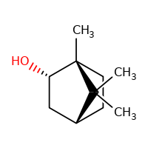
Supporting Paper 2: Borneol co-administered with nanoparticles (NPs)
What is borneol?
Borneol is a “simple bicyclic monoterpene”
Increases absorption at a variety of tissues including at BBB
Can be given prior to or co-administered with drug treatments
Borneol
NIH, US National Library of Medicine (2016); Zhang, et al. (2013)
Notes:
National Institutes of Health, U.S. National Library of Medicine. (2016). Toxicology Data Network: Borneol. Retrieved from: https://toxnet.nlm.nih.gov/cgi-bin/sis/search/a?dbs+hsdb:@term+@DOCNO+946
Zhang, L., Han, L., Qin, J., Lu, W., & Wang, J. (2013). The use of borneol as an enhancer for targeting aprotinin-conjugated PEG-PLGA nanoparticles to the brain. Pharm Res, 30, 2560-2572. doi: 10.1007/s11095-013-1055-y

Slide 16
Supporting Paper 2: Borneol co-administered with nanoparticles (NPs)
What can borneol do?
Widely used in traditional Chinese medicine
Enhances drug permeation to target tissues, including brain
Unknown (Hypotheses to test)
Can Borneol increase NP transport across BBB?
Can Borneol co-administration with drug-loaded NPs improve behavior in Alzheimer’s disease rats compared to drug-loaded NPs alone?
Borneol
NIH, US National Library of Medicine (2016); Zhang, et al. (2013)
Notes:
Widely used in traditional Chinese medicine
Enhanced drug permeation through skin, gastrointestinal mucous membrane, nasal mucosa, cornea, and the BBB
Can accelerate the opening of the BBB to enhance drug distribution in brain tissue
National Institutes of Health, U.S. National Library of Medicine. (2016). Toxicology Data Network: Borneol. Retrieved from: https://toxnet.nlm.nih.gov/cgi-bin/sis/search/a?dbs+hsdb:@term+@DOCNO+946

Slide 17
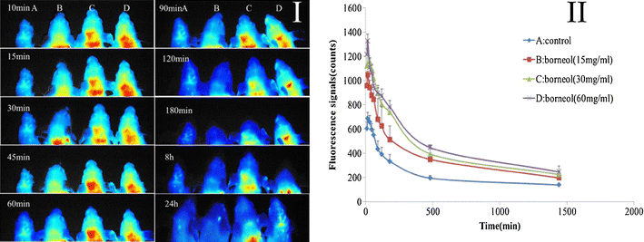
Supporting Paper 2 Major Results
Co-administration of Borneol with NPs increased NP delivery to brain
Zhang, et al. (2013)
Notes:
Rats received gastric administration of borneol
Brain injection of NPs
Zhang, L., Han, L., Qin, J., Lu, W., & Wang, J. (2013). The use of borneol as an enhancer for targeting aprotinin-conjugated PEG-PLGA nanoparticles to the brain. Pharm Res, 30, 2560-2572. doi: 10.1007/s11095-013-1055-y

Slide 18
Morris Water Maze
Wolbers & Wiener (2014)
Notes:
Wolbers, T., & Wiener, J. M. (2014). Challenges for identifying the neural mechanisms that support spatial navigation: the impact of spatial scale. Front Hum Neurosci, 571(8). doi: https://doi.org/10.3389/fnhum.2014.00571

Slide 19
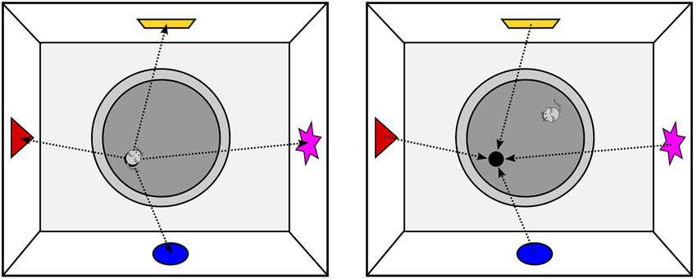
Morris Water Maze
Wolbers & Wiener (2014)
Notes:
Wolbers, T., & Wiener, J. M. (2014). Challenges for identifying the neural mechanisms that support spatial navigation: the impact of spatial scale. Front Hum Neurosci, 571(8). doi: https://doi.org/10.3389/fnhum.2014.00571

Slide 20
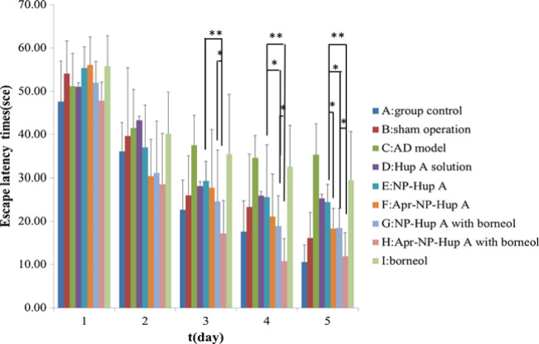
Supporting Paper 2 Major Results
Co-administration of Borneol with drug-loaded NPs improved learning in AD rats (decreased latency during Morris Water Maze) compared to drug-loaded NPs alone
Zhang, et al. (2013)
Notes:
Zhang, L., Han, L., Qin, J., Lu, W., & Wang, J. (2013). The use of borneol as an enhancer for targeting aprotinin-conjugated PEG-PLGA nanoparticles to the brain. Pharm Res, 30, 2560-2572. doi: 10.1007/s11095-013-1055-y

Slide 21
Supporting Papers Major Conclusions
Modifying NPs with Lactoferrin prolongs and increases DA release in brain
Borneol co-administration with drug-loaded NPs enhances drug delivery to the brain
Yan, et al. (2018); Zhang, et al. (2013)
Notes:
Yan, X., Xu, L., Bi, C., Duan, D., Chu, L., et al. (2018). Lactoferrin-modified rotigotine nanoparticles for enhanced nose-to-brain delivery: LESA-MS/MS-based drug biodistribution, pharmacodynamics, and neuroprotective effects. International Journal of Nanomedicine, 13, 273-281. doi: http://dx.doi.org/10.2147/IJN.S151475
Zhang, L., Han, L., Qin, J., Lu, W., & Wang, J. (2013). The use of borneol as an enhancer for targeting aprotinin-conjugated PEG-PLGA nanoparticles to the brain. Pharm Res, 30, 2560-2572. doi: 10.1007/s11095-013-1055-y

Slide 22
Topic Paper: Brain-targeted intranasal delivery of dopamine with borneol and lactoferrin co-modified nanoparticles for treating Parkinson’s disease
Tang, et al. (2019)
Notes:
Tang, S., Wang, A., Yan, X., Chu, L., Yang, X., et al. (2019). Brain-targeted intranasal delivery of dopamine with borneol and lactoferrin co-modified nanoparticles for treating Parkinson’s disease. Drug Delivery, 26(1), 700-707. doi: https://doi.org/10.1080/10717544.2019.1636420

Slide 23
The Goal
Even nanoparticles (NPs) may be cleared too quickly from nasal cavity to improve transport of drugs to the brain
Topic Paper Hypothesis: Co-modifying NPs with both lactoferrin and borneol will retain NP in the nasal cavity to increase DA delivery to brain
Encapsulate DA into nanoparticles (NPs)
Increase delivery of DA to brain by coating NP with:
respiratory ligand lactoferrin to retain in nasal cavity
borneol to increase permeation to brain
Tang, et al. (2019)
Notes:
Tang, S., Wang, A., Yan, X., Chu, L., Yang, X., et al. (2019). Brain-targeted intranasal delivery of dopamine with borneol and lactoferrin co-modified nanoparticles for treating Parkinson’s disease. Drug Delivery, 26(1), 700-707. doi: https://doi.org/10.1080/10717544.2019.1636420

Slide 24
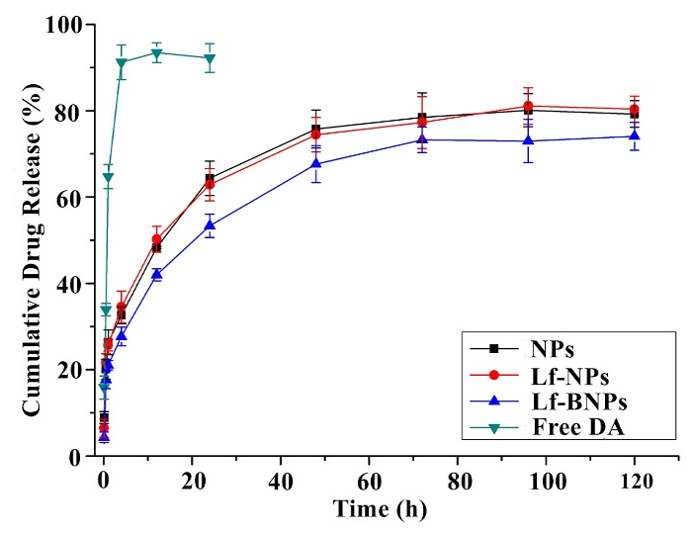
Results: In vitro release kinetics
Testing release of DA from NP formulations in just PBS solution
NPs reached up to 70% release of their DA contents by 72 hours
Naked NPs and Lf-NPs showed higher release than Lf-BNPs
NP formulations demonstrate sustained release as compared to free DA
Tang, et al. (2019)
Notes:
Demonstrates sustained release because it takes three days to reach 70% release
Tang, S., Wang, A., Yan, X., Chu, L., Yang, X., et al. (2019). Brain-targeted intranasal delivery of dopamine with borneol and lactoferrin co-modified nanoparticles for treating Parkinson’s disease. Drug Delivery, 26(1), 700-707. doi: https://doi.org/10.1080/10717544.2019.1636420

Slide 25
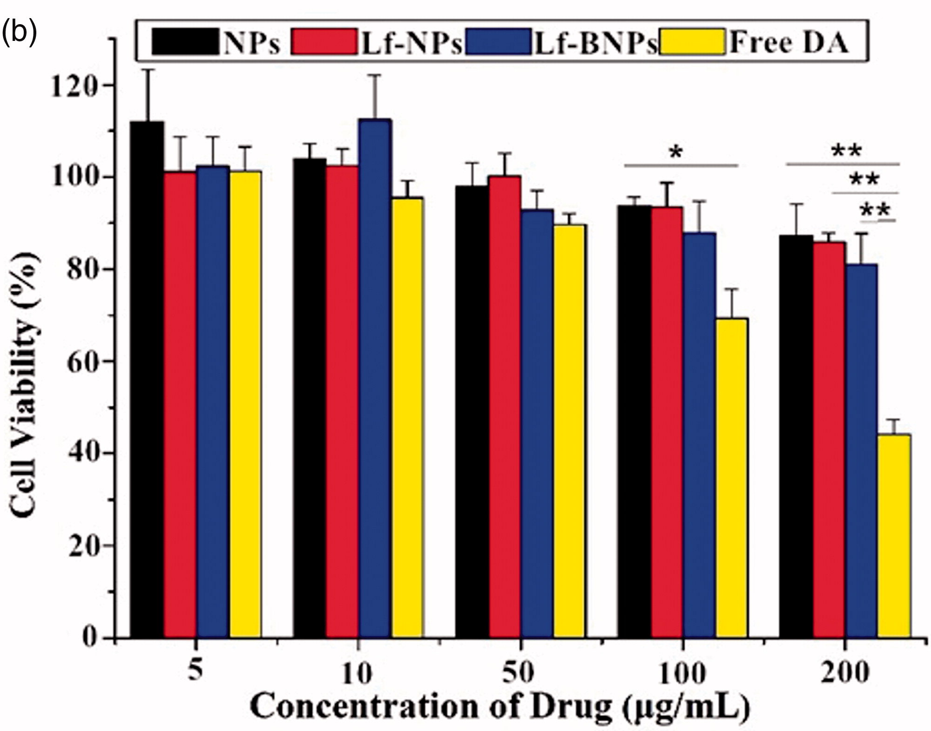
Results: In vitro cytotoxicity assessment
Looking at cell viability of different administration doses (MTT assay)
NP formulations did not induce sig. cell death at any concentration
16HBE cells
NP formulations decrease toxicity as compared to free DA
Tang, et al. (2019)
Notes:
Significance is showing free-DA compared to the other formulations
Showing results for 16HBE cells = human bronchial epithelial cell line
Very similar to results for SH-SY5Y cells = human derived neuronal cell line
ALSO, no significant differences between Lf-NPs and Lf-BNPs, demonstrating both borneol and Lf are nontoxic
Tang, S., Wang, A., Yan, X., Chu, L., Yang, X., et al. (2019). Brain-targeted intranasal delivery of dopamine with borneol and lactoferrin co-modified nanoparticles for treating Parkinson’s disease. Drug Delivery, 26(1), 700-707. doi: https://doi.org/10.1080/10717544.2019.1636420

Slide 26
Results: Cellular uptake of NPs
Lactoferrin and Borneol promote cellular uptake of NP,
Borneol increases cellular uptake even more in bronchial cells
Qualitative analysis: fluorescent microscopy (left)
Quantitative analysis: flow cytometry (right)
Tang, et al. (2019)
Notes:
Showing results for 16HBE cells = human bronchial epithelial cell line
Very similar to results for SH-SY5Y cells = human derived neuronal cell line
For both cell lines, Lf-NPs were taken up significantly more than naked NPs
For 16HBE cells, Lf-BNPs were taken up significantly more than Lf-NPs as well, so the bronchial epithelial cells can be promoted by borneol to uptake more NPs
Tang, S., Wang, A., Yan, X., Chu, L., Yang, X., et al. (2019). Brain-targeted intranasal delivery of dopamine with borneol and lactoferrin co-modified nanoparticles for treating Parkinson’s disease. Drug Delivery, 26(1), 700-707. doi: https://doi.org/10.1080/10717544.2019.1636420

Slide 27
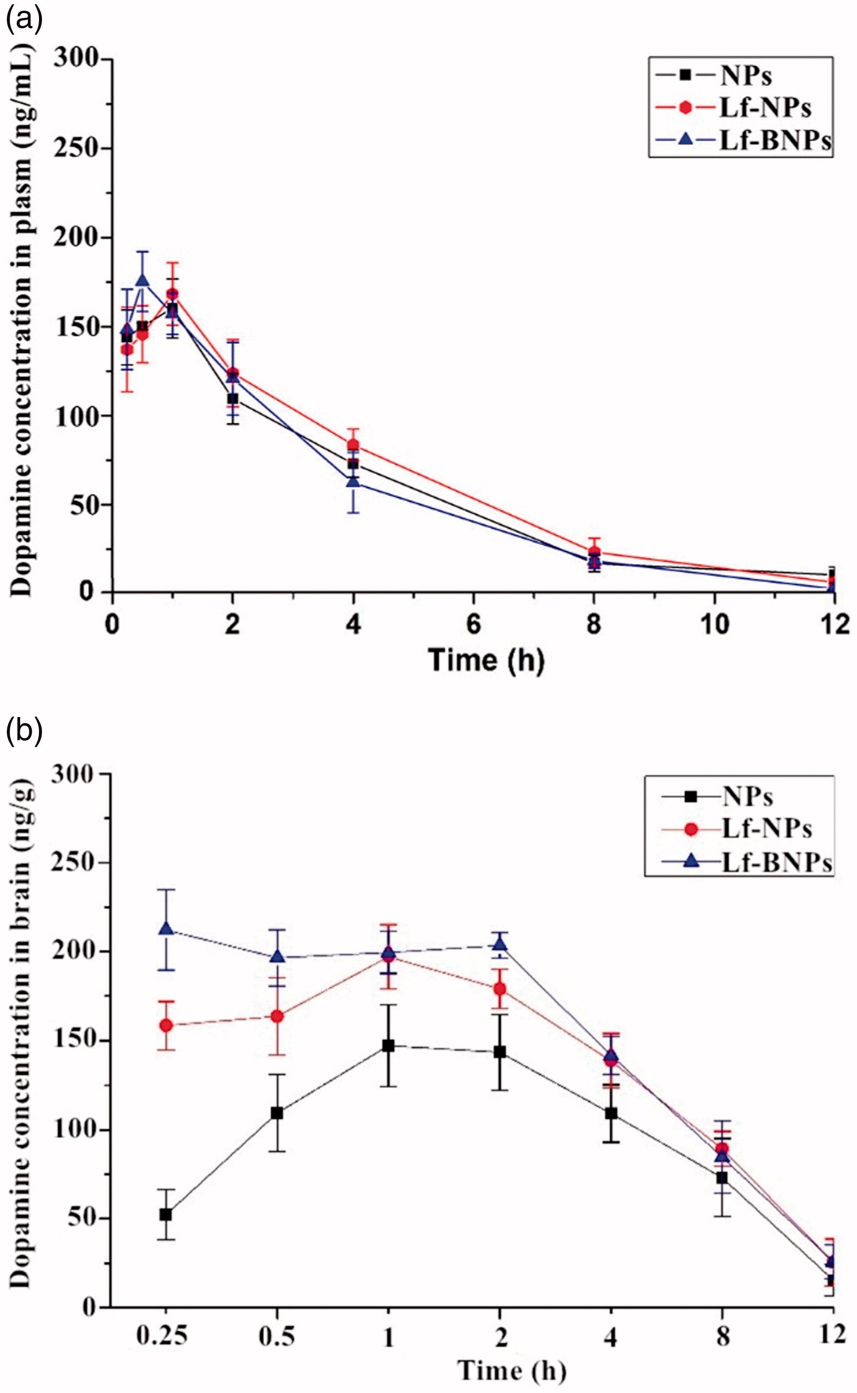
Results: Pharmacokinetic study
Modified NPs significantly increase DA delivery to brain
Concentration of NPs over time in plasma (left) and brain (right)
Plasma
Brain
Tang, et al. (2019)
Notes:
Plasma concentration did not change between NP formulations, so the modifications do not alter circulation characteristics of the NPs
Brain concentrations were different:
Lf-NPs and Lf-BNPs were significantly higher than naked NPs at all time points
Lf-BNPs were significantly higher than Lf-NPs at 0.25 and 0.5 hours (so borneol may be effective at promoting drug permeation into brain)
Tang, S., Wang, A., Yan, X., Chu, L., Yang, X., et al. (2019). Brain-targeted intranasal delivery of dopamine with borneol and lactoferrin co-modified nanoparticles for treating Parkinson’s disease. Drug Delivery, 26(1), 700-707. doi: https://doi.org/10.1080/10717544.2019.1636420

Slide 28
Results: Pharmacodynamics study
First: contralateral rotation behavior
6-OHDA treatment in striatum abolishes DA neurons, inducing PD model
Apomorphine (DA receptor agonist) treatment then leads PD rats to rotate in a hypersensitive fashion contralateral to side of lesion
Stefanova & Wenning (2015); Tang, et al. (2019)
Notes:
6-OHDA = 6-hydroxydopamine rats. 6-OHDA treatment in rats abolishes DA in striatum and develops an effective PD model
Stefanova, N. & Wenning, G. K. (2015). Animal models of multiple system atrophy. Clin Auton Res, 25, 9-17. doi: 10.1007/s10286-014-0266-6
Tang, S., Wang, A., Yan, X., Chu, L., Yang, X., et al. (2019). Brain-targeted intranasal delivery of dopamine with borneol and lactoferrin co-modified nanoparticles for treating Parkinson’s disease. Drug Delivery, 26(1), 700-707. doi: https://doi.org/10.1080/10717544.2019.1636420

Slide 29
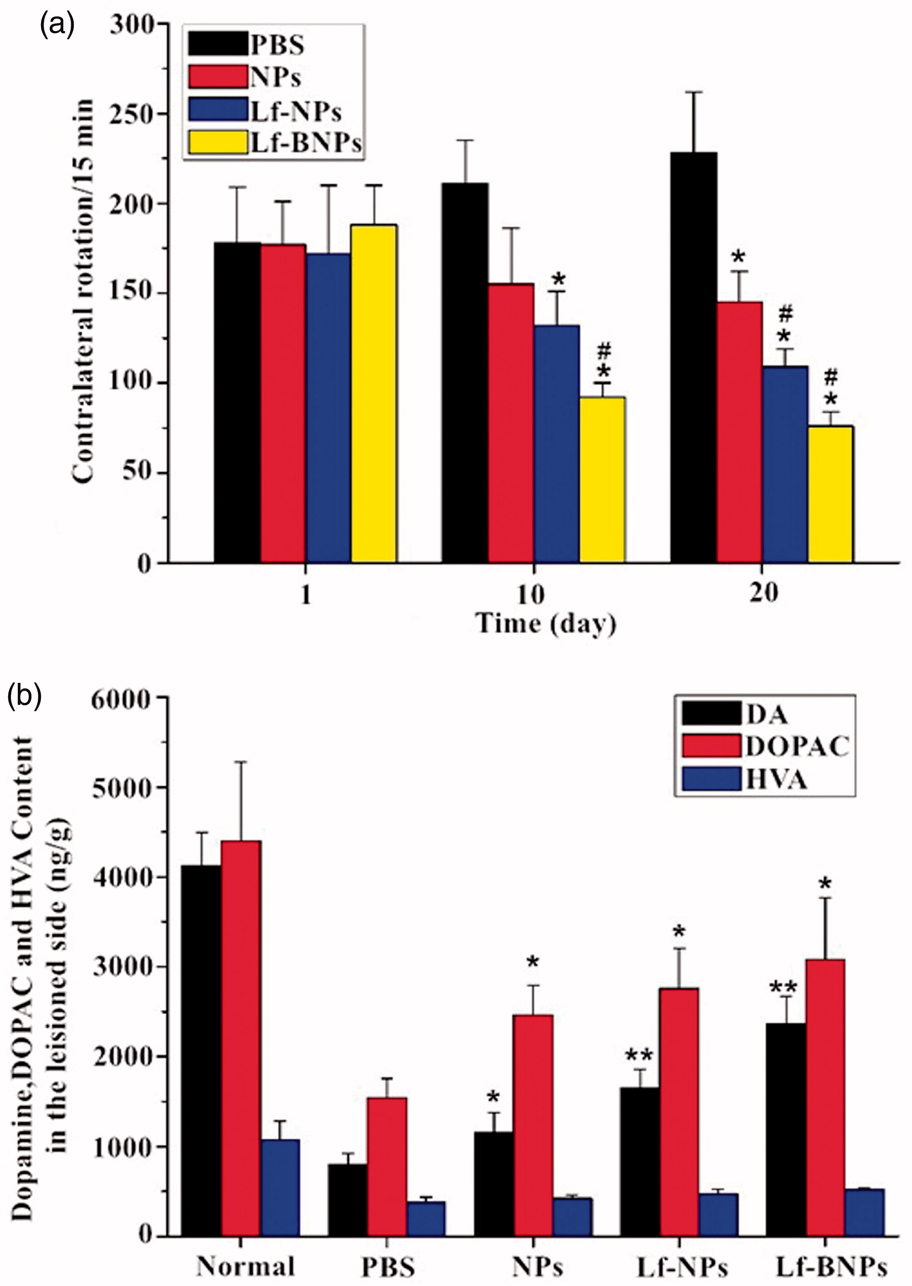
Results: Pharmacodynamics study
Testing therapeutic efficacy of modified NPs in Parkinson’s disease rats
NP formulations significantly improved DA signaling in rats
Lactoferrin and borneol NPs surpassed naked NPs
Tang, et al. (2019)
Notes:
After 10 and 20 days of treatment, Lf-NP and Lf-BNP treated rats showed significantly decreased contralateral rotations (improved DA signaling)
By 10 days, the Lf-BNPs was more sig. than the naked NPs
And by 20 days, the Lf-NPs AND Lf-BNPS were more sig. than the naked NPs
Asterisk = versus PBS group
Pound sign = versus naked NP group
Tang, S., Wang, A., Yan, X., Chu, L., Yang, X., et al. (2019). Brain-targeted intranasal delivery of dopamine with borneol and lactoferrin co-modified nanoparticles for treating Parkinson’s disease. Drug Delivery, 26(1), 700-707. doi: https://doi.org/10.1080/10717544.2019.1636420

Slide 30
Results: Pharmacodynamics study
Testing therapeutic efficacy of modified NPs in Parkinson’s disease rats
NP formulations restored DA levels in lesioned striatum significantly more than PBS group
Tang, et al. (2019)
Notes:
DA = dopamine
DA metabolites:
DOPAC = dihydroxyphenylacetic acid
HVA = homovanillic acid
Asterisk = versus PBS group, p < 0.05
Double asterisk p < 0.01
Hard to say if Lf or Borneol are having a statistically significant effect here?
Tang, S., Wang, A., Yan, X., Chu, L., Yang, X., et al. (2019). Brain-targeted intranasal delivery of dopamine with borneol and lactoferrin co-modified nanoparticles for treating Parkinson’s disease. Drug Delivery, 26(1), 700-707. doi: https://doi.org/10.1080/10717544.2019.1636420

Slide 31
Summary of Findings
Cell viability demonstrated low toxicity of Lactoferrin and Borneol
Lactoferrin and Borneol modifications increased cellular uptake of NPs
Lf-BNPs demonstrated increased absorption of DA into brain
PD rats showed decreased contralateral rotations and increased DA content in their lesioned striatum following NP treatment
Tang, et al. (2019)
Notes:
This slide may need some work
I feel like they could have done a better job at checking their statistics. Like with the last figure. Is there any significance between NP formulations? How much better ARE Lf-BNPs from Lf-NPs? Didn’t seem to make THAT much of a difference.
Tang, S., Wang, A., Yan, X., Chu, L., Yang, X., et al. (2019). Brain-targeted intranasal delivery of dopamine with borneol and lactoferrin co-modified nanoparticles for treating Parkinson’s disease. Drug Delivery, 26(1), 700-707. doi: https://doi.org/10.1080/10717544.2019.1636420

Slide 32
Major Take Home Messages
Lactoferrin and Borneol co-modifications of DA-loaded NPs led to improvement of PD symptoms in rats as demonstrated by:
Increased levels of DA in the brain
Improved behavior in PD rat model
Increased striatum DA levels in PD rat model
“In conclusion, the results demonstrated that the drug delivery system in this study could provide an effective non-invasive approach to encourage the access of dopamine to the brain for treatment of PD” (Tang, et al., 2019)
Tang, et al. (2019); Yan, et al. (2018); Zhang, et al. (2013)
Notes:
Tang, S., Wang, A., Yan, X., Chu, L., Yang, X., et al. (2019). Brain-targeted intranasal delivery of dopamine with borneol and lactoferrin co-modified nanoparticles for treating Parkinson’s disease. Drug Delivery, 26(1), 700-707. doi: https://doi.org/10.1080/10717544.2019.1636420
Yan, X., Xu, L., Bi, C., Duan, D., Chu, L., et al. (2018). Lactoferrin-modified rotigotine nanoparticles for enhanced nose-to-brain delivery: LESA-MS/MS-based drug biodistribution, pharmacodynamics, and neuroprotective effects. International Journal of Nanomedicine, 13, 273-281. doi: http://dx.doi.org/10.2147/IJN.S151475
Zhang, L., Han, L., Qin, J., Lu, W., & Wang, J. (2013). The use of borneol as an enhancer for targeting aprotinin-conjugated PEG-PLGA nanoparticles to the brain. Pharm Res, 30, 2560-2572. doi: 10.1007/s11095-013-1055-y

Slide 33
Discussion Questions
Several sets of data showed the Lactoferrin modified NPs seemed to work just as well as the Borneol and Lactoferrin co-modified NPs (for example, see the last graph of data). What future work do you think needs to be done to demonstrate a clear co-modification benefit?
Also: the researchers analyzed the data by one-way ANOVA. Wouldn’t a factorial ANOVA been more appropriate in order to compare between the NP groups as well as back to the control groups?
They only used male rats in this study. Do you think it would be necessary to test co-modified NPs in female rats as well before moving into more complex systems?
Tang, et al. (2019); Yan, et al. (2018); Zhang, et al. (2013)

